Slide 1
Automatic Guitar Tuner
https://github.com/JackP2112/IoTProjectSemester2

Slide 2
Project Objectives
To develop a system which will automatically tune a stringed instrument, such as a guitar.
The three components of this system are:
A microphone – which must be able to accurately measure the pitch of a note.
A user interface – to let the user select pitch and receive information.
This includes:
Buttons – to allow for very basic navigation of the system.
A screen – for visual feedback to the user.
A motor – to change the tension in the string, thereby changing the frequency.

Slide 3
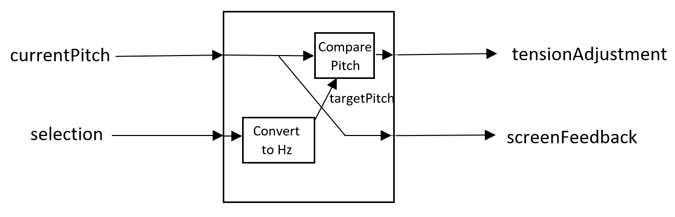
Design
The system allows for a user to select a note (selection) and have it be compared against the pitch of the instrument (currentPitch). This then translates to either an increase or decrease of tension in the string (tensionAdjustment).
If the pitches are equal, the instrument is in tune.

Slide 4
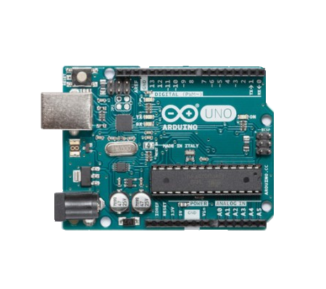
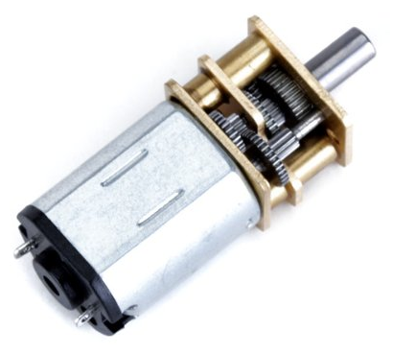
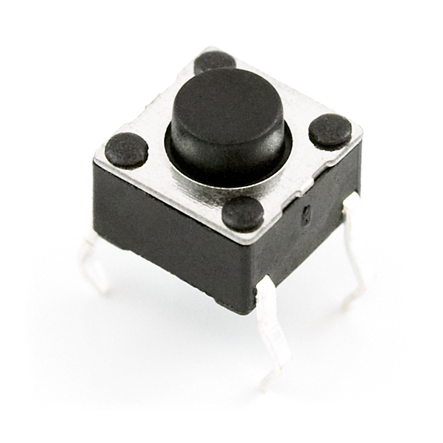
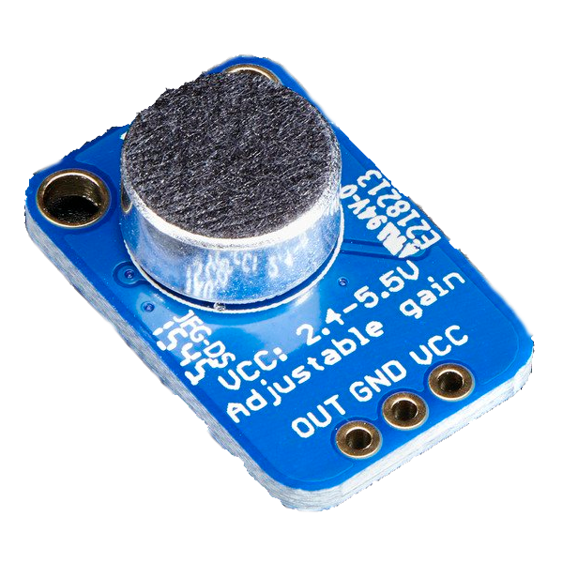
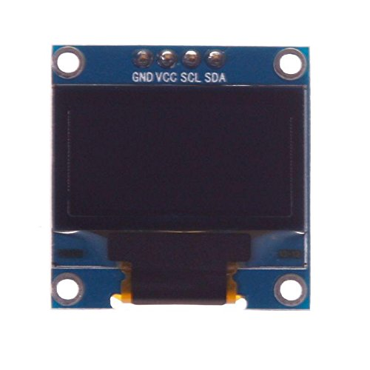
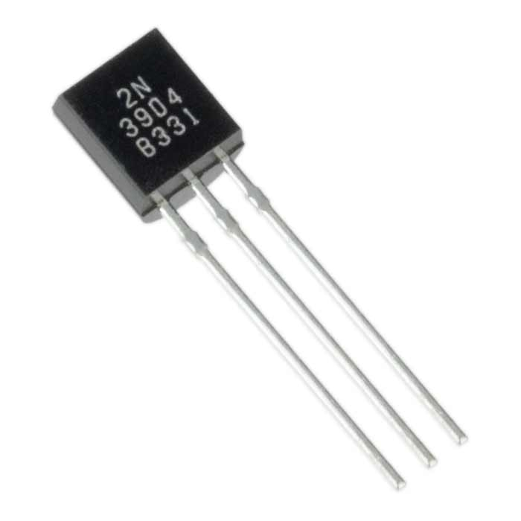
Technology
Arduino –
Controls system process.
Buttons –
Allows for simple user input.
Motor –
Adjusts string tension.
Microphone –
Picks up sound waves.
OLED Display –
Displays information to user.
Transistors –
Used to switch current.

Slide 5
Problems Encountered
A limited knowledge of the Arduino Language made programming and debugging more difficult.
Some libraries were found to be incompatible with the hardware used.
Ordered parts arrived later than hoped, delaying progress. Solutions:
Much of the code was found online and researching errors often fixed them.
Alternative, compatible libraries existed, as well as online edits to fix them.
The large amount of documentation online made it possible to write code for parts I didn’t already have.

Slide 6
What I learned
Some of the ways software can interact with the real world, and vice versa.
Breaking up a problem into manageable, independent pieces.
Source control (with Git).
To work around unavoidable obstacles.
The value of having a good specification, early on.

Slide 7
Conclusion
Some things could definitely be improved and refined.
The system has much to be desired from a usability standpoint.
Possible improvements might include a better user input system, making it more compact and mountable, or possibly some wireless implementation.
Questions?

